Slide 1
Attention Is All You Need

Slide 2
Introduction
Eschews recurrence in sequence modeling and transduction.
Relies on attention mechanism for global dependencies.
Improves state-of-the-art approaches.

Slide 3
Literature Review
Utilizes attention mechanisms for sequence modeling and transduction models.
Models dependencies without considering distance in input/output sequences.
Avoids recurrence in model architecture.
Dependencies drawn between input and output are entirely based on attention mechanisms.

Slide 4
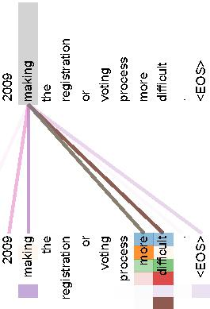
Literature Review

Slide 5
Methodology
Stack of identical layers.
Each layer has two sub-layers: multi-head self-attention mechanism and position-wise fully connected feed-forward network.
Employs residual connection and layer normalization.

Slide 6
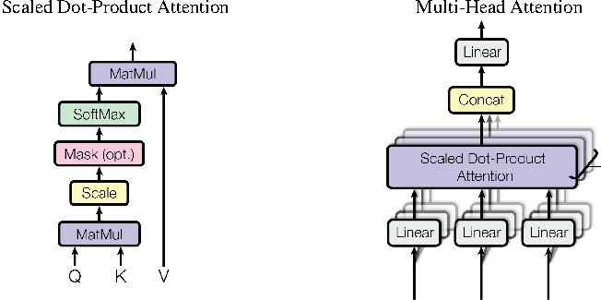
Methodology

Slide 7
Results
Models outperform in quality, parallelizability, and training time.
WMT 2014 English-to-German translation task: Model achieves state-of-the-art BLEU score of 41.8 after 3.5 days training on eight GPUs.

Slide 8
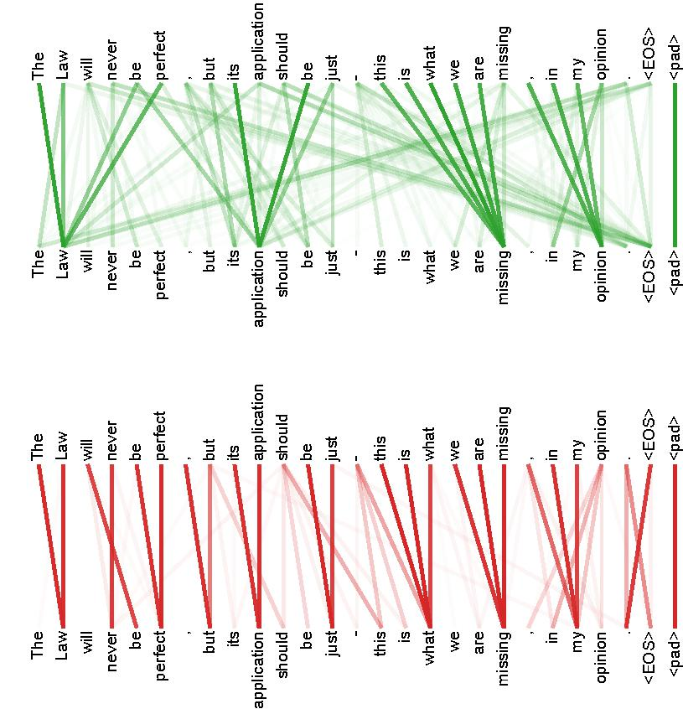
Results

Slide 9
Conclusion
Simple network architecture based on attention mechanisms.
Eliminates recurrence and convolution.
Superior quality, parallelizability, and training time.
Model achieves 28.4 BLEU on WMT 2014 English-to-German translation task.
Training costs are small fraction of literature's best models.

